Slide 1
Strangers & exiles
1 Peter 2:1-12

Slide 2


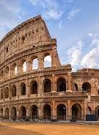
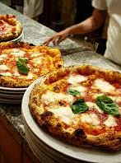
When in Rome …?
There are times when fitting in is …
A good thing to to do
A not so good thing to do
But, how do we know when to FIT IN and when not to?

Slide 3

A principle
WHAT WE DO ARISES FROM WHO WE ARE
BEING TRUE TO WHO WE ARE

Slide 4
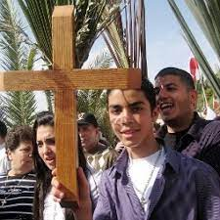
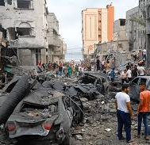
Who we are before the world
Strangers and exiles
A Palestinian Christian?
A NZ Christian?

Slide 5
Who we are before God
Who we are arises from whose we are
We are the people of Jesus – chosen and precious
Priests and kings
All and only by God’s mercy

Slide 6
Being who we are
Within ourselves: resisting evil desires
Outwardly: living good lives that commend god

Slide 7

Today’s big questions
Who are we?
Strangers and exiles AND the people of God
Whose are we?
We belong to the living God through Jesus his Son
What should we do?
Be who we are

