Slide 1
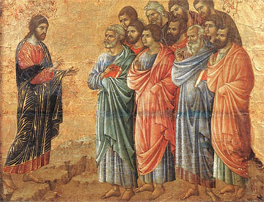
Jesus Sends the Twelve
Luke 9:1-10

