Slide 1
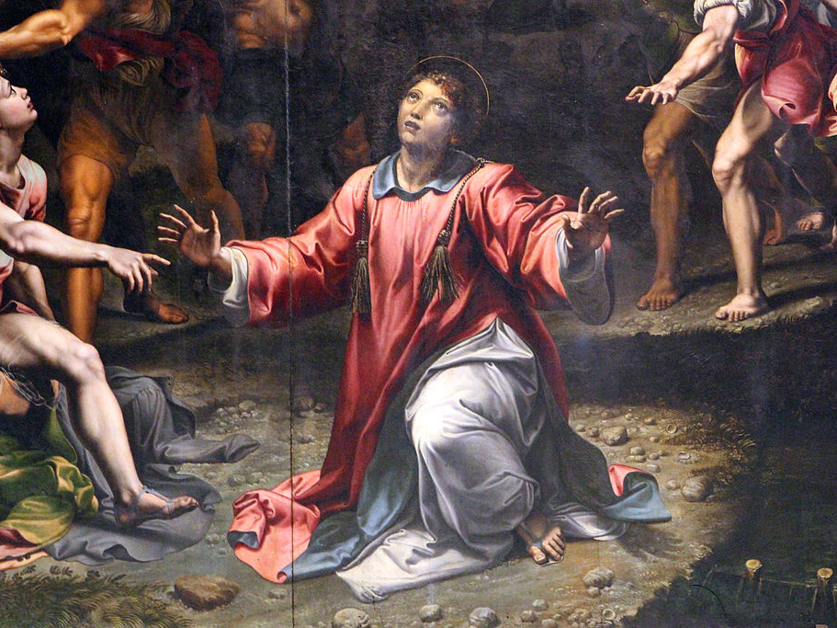
Persecution: no harm, just another gospel opportunity
Luke 21:12-19

Slide 2
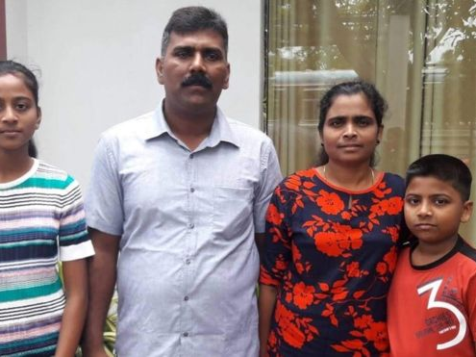
Ramesh Raju and family

