Slide 1
Benedictus: your joy because God promised
Luke 1:57-80

Slide 2

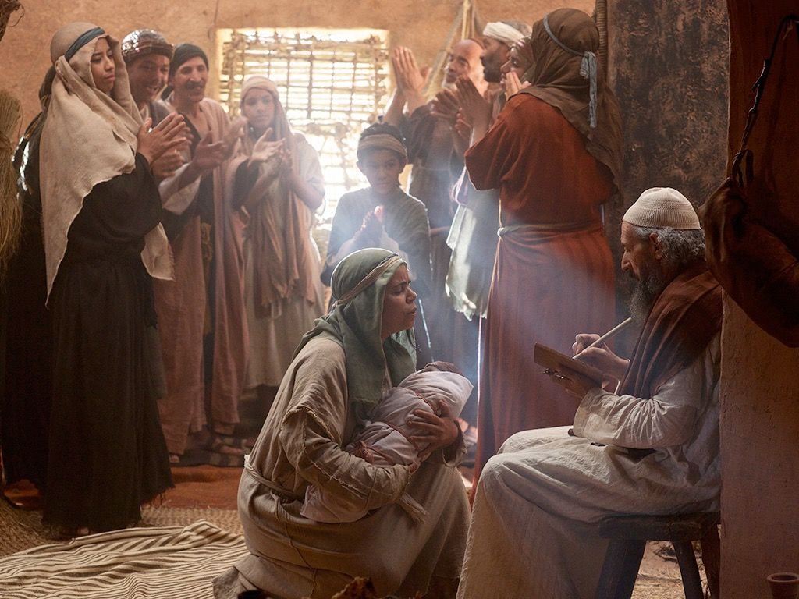


Zechariah & Elizabeth
A baby party
“His name is John”
“What then is this child going to be?”
Zechariah prophesies

Slide 3

Your joy through God’s promise
God wants you to serve him with joy

Slide 4
Your joy through God’s promise
God wants you to serve him with joy
God will give you joy because of his ancient promise

