Slide 1
‘I believe…in the forgiveness of sins’
Mark 2:1-12

Slide 2


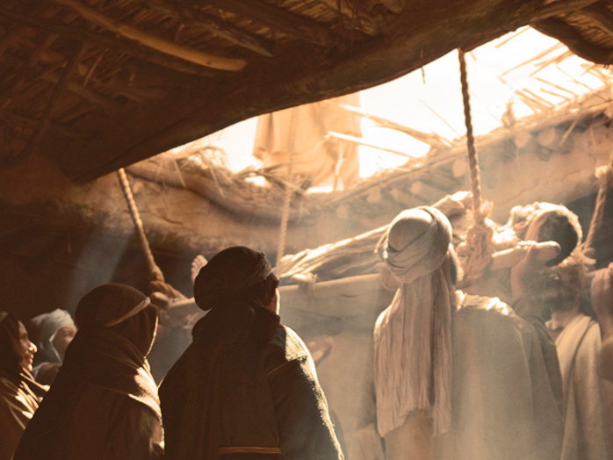

Mark 2:1-12
z
A crowded house
Faith in action
Jesus: healer of body and soul
Your response: faith or rejection?

Slide 3
God,
the forgiver of sins.

