Slide 1

Sharing Your Faith: sharing with Sikhs
1 Peter 3.15-16

Slide 2
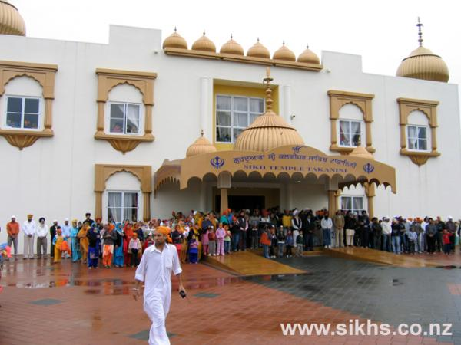
Our Neighbours: Sikhs in Takanini:

Slide 3
What Sikh’s believe
There is only one God (no Trinity)
God is without form, or gender (not a Person)
God is in everything: (not able to stand alone)
Everyone has direct access to God (no Mediator, not sinners)
A good life is lived as part of a community, by living honestly and caring for others (works, not faith)
The sacred Scriptures, Guru Granth Sahib are at the centre of Sikh beliefs and worship. These are the revelations of God to the ten gurus.

Slide 4
The Three Duties of Sikhism:
Pray: keep God in mind at all times
Work: earn an honest living
Give: giving to charity and caring for others

Slide 5
The Five Ks of Sikhism:
Hair (Kesh): Hair is holy, and as a gift from God, shouldn’t be cut off. It symbolises denial of self and a spiritual life.
Steel bracelet (kara): reminder to live for God, not do anything the Guru forbids, and that God is eternal.
Wooden Comb (Kanga): Symbolises cleanliness of body and mind.
Cotton Underwear (Kaccha): a symbol of chastity.
A Steel Dagger or sword (Kirpan): a ceremonial or real dagger to symbolise spirituality, defence of the good, and defence of Sikhism.

Slide 6
The Four Taboos of the Takanini Gurwara
Do not cut your hair
Do not commit adultery
Do not partake in tobacco or alcohol
Do not eat Halal meat (many Sikhs are vegetarian)

Slide 7
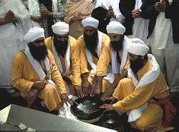

Initiations & Holy Days
Initiation ceremony: Amrit
Holy Days: Diwali

Slide 8
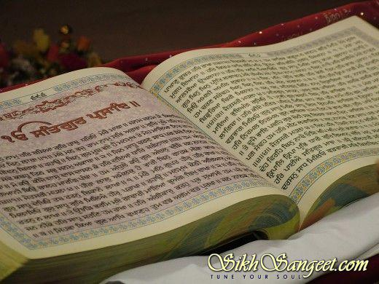
Salvation: how a Sikh is saved
God inside
…rebirth, life, death, rebirth, life, death, rebirth, life, death, rebirth…
Follow the Guru Granth Sahib (scriptures) and to please God and break

Slide 9

Sharing your faith with a Sikh: John14:6
Culture is not the way (or in the way):
Jesus doesn’t point to the way:
Jesus is the Way:

Slide 10
Let us pray for our Sikh neighbours…

