Slide 1
The Trinity
Jesus told his disciples to baptise people in the name of "The Father, the Son and the Holy Spirit“
What is the Trinity?
There is One God
The Lord is the only God
Jesus says that there is only one God
But Jesus says that he is part of God
God is also Three
The Father is God
Jesus is also God
John the Baptist called Jesus God ("The Lord")
Jesus called himself the same names as God - "I Am"
He said he was God
Was Jesus telling the truth or lying?
The Holy Spirit is God
The Holy Spirit was part of creation
The Bible calls the Holy Spirit God
How can we worship the Trinity?
We need to worship all of God - the Trinity
People were made in the likeness of God
We obey God the Father and copy Jesus with the Spirit helping us
Grace, love and fellowship - the Trinity shows it perfectly, and we can experience it with God

Slide 2
"Therefore I tell you, do not worry about your life, what you will eat or drink; or about your body, what you will wear. Is not life more important than food, and the body more important than clothes?
Matthew 6:25

Slide 3
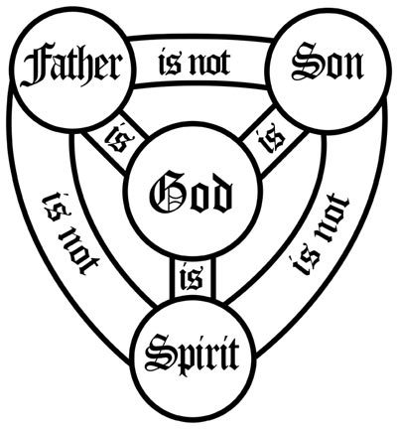

Slide 4
